Slide 1

C#
Roopak Gowda Krishna
Rajat Agarwal

Slide 2
What are we going to learn ?
DAY 1 | Day 2
.NET Framework & C# Syntax | Classes & Objects
Data types | Constructor
Operators | Static variables
Nullable Types and Datatype conversions | OOPS → Abstraction → Encapsulation → Inheritance → Polymorphism
Array
Decision Making & Looping
Methods | Interfaces
Fields and Properties | Exception handling
Access modifiers | Comments & Naming Convention

Slide 3
What is .NET?
Web Services
Sharepoint
...
Building Blocks (e.g. for Services)
...
.NET Applications
Enterprise Servers
Languages:
C#, Visual Basic, etc
CLR
SQL Server
BizTalk
...
Runtime
Common
Type
System
Common
Language
Runtime
Services: .NET and COM+
CTS
.NET Framework
Operating System

Slide 4
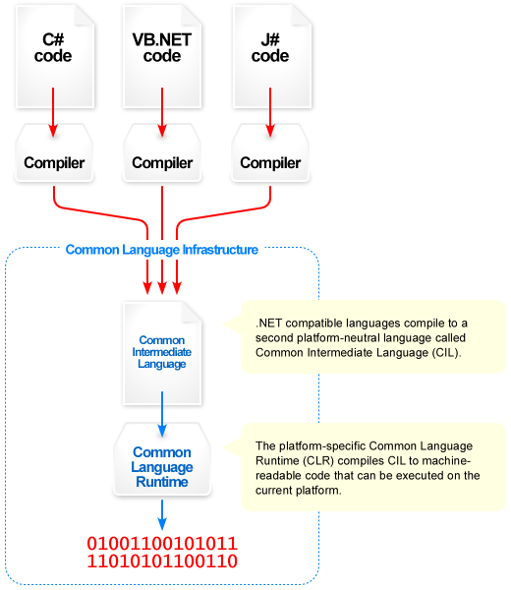
What is the CLR?
Base Class Library Support
Thread Support
COM Marshaler
Type Checker
Exception Manager
Security Engine
Debug Engine
MSIL to Native
Compilers (JIT)
Code
Manager
Garbage
Collector (GC)
Class Loader

Slide 5
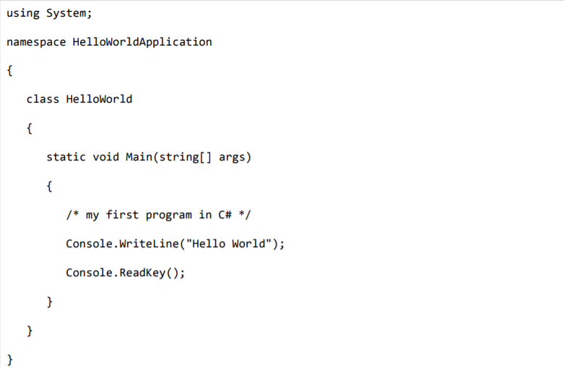
C# syntax…

Slide 6
Let’s start coding…
Notes:
Visual studio IDE
Create a console App

Slide 7
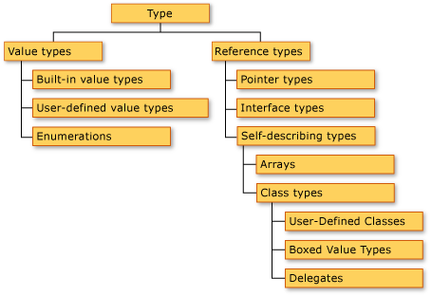
Data Types.
Built- in types
int | System.Int32
uint | System.UInt32
sbyte | System.SByte
byte | System.Byte
short | System.Int16
ushort | System.UInt16
long | System.Int64
ulong | System.UInt64
float | System.Single
double | System.Double
decimal | System.Decimal
char | System.Char
string | System.String
object | System.Object
Notes:
variables

Slide 8
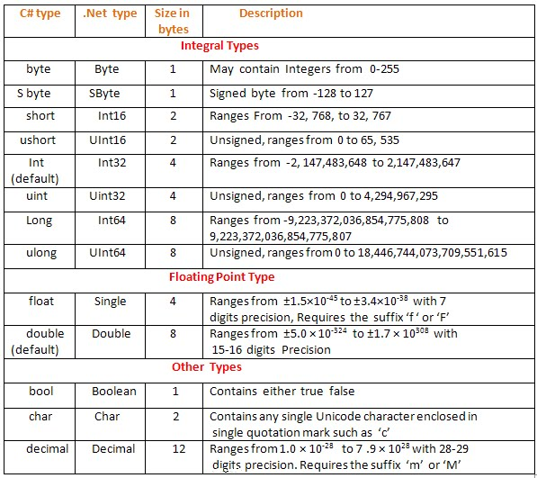
Data Types contd..

Slide 9
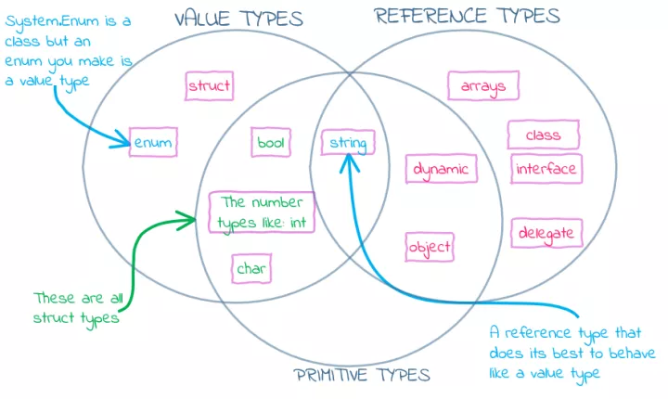

Slide 10
Operators

Slide 11
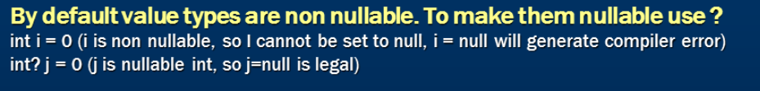
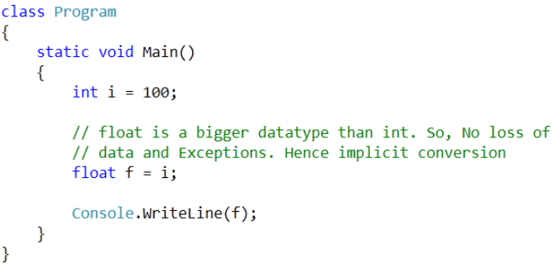
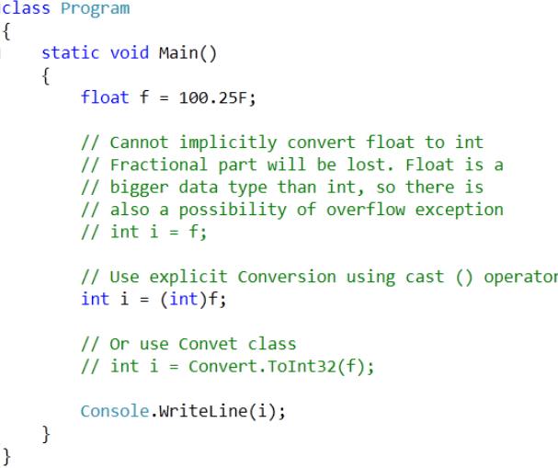
Nullable Types and Datatype conversions
Implicit Conversion
Explicit Conversion

Slide 12
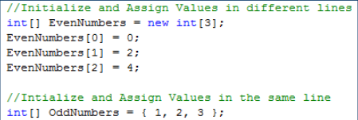
Arrays
Array is a collection of similar datatypes.
Notes:
Index, names example.

Slide 13
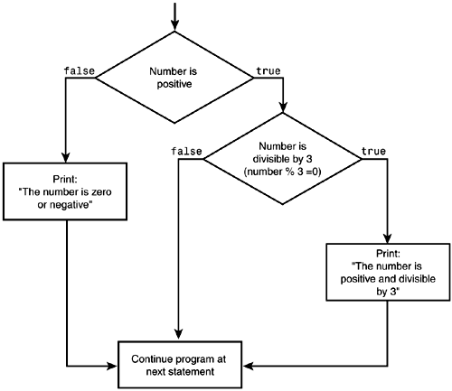
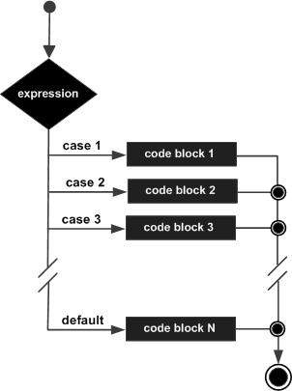
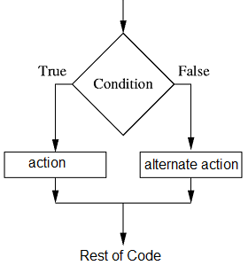
Decision making
IF / Else if
Nested If
Switch Case

Slide 14
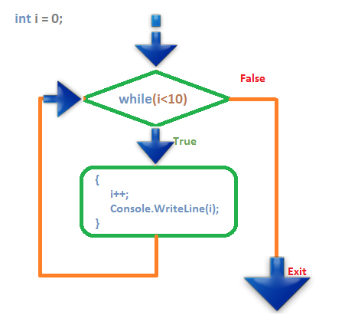
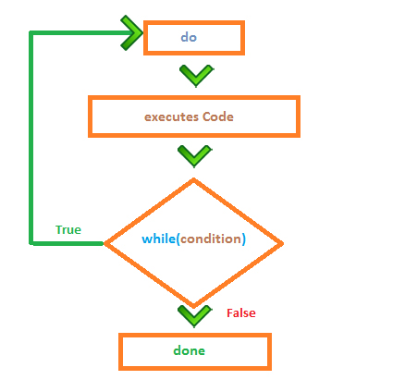
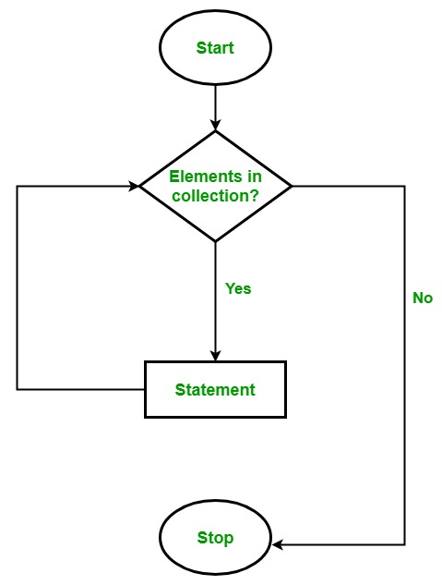
Looping
While
Do while
For / Foreach
Notes:
Print odd/even

Slide 15
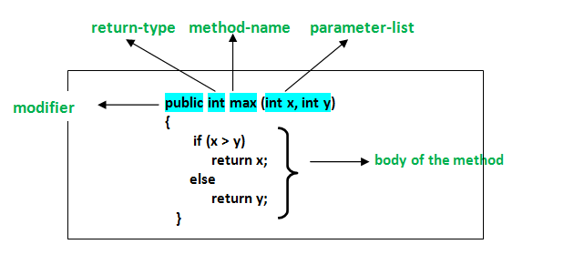
Methods

Slide 16
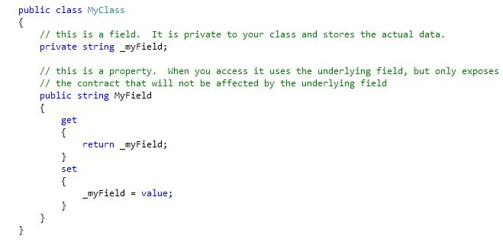
Fields and Properties

Slide 17
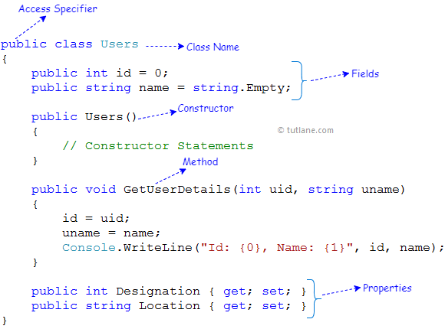
Classes & Objects

Slide 18
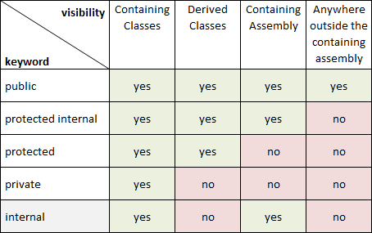
Access modifiers

Slide 19
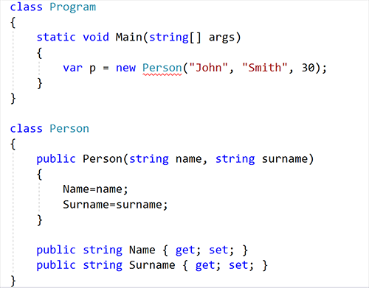
Constructor

Slide 20
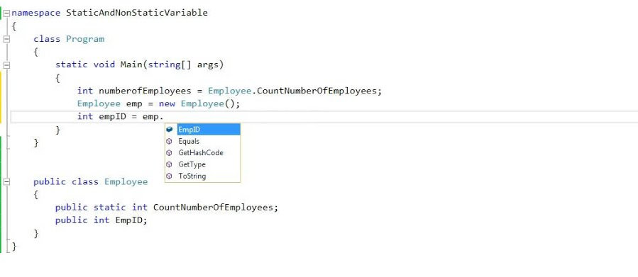
Static variables

Slide 21
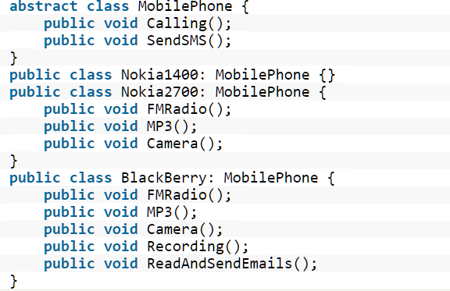
OOPS → Abstraction
Abstraction is "To represent the essential feature without representing the background details.“
Abstraction means putting all the variables and methods in a class that are necessary

Slide 22
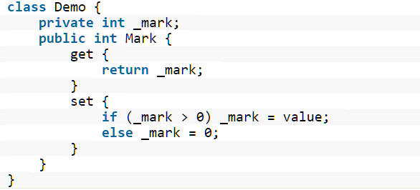
OOPS → Encapsulation
Wrapping up a data member and a method together into a single unit (in other words class) is called Encapsulation.
Encapsulation prevents clients from seeing its inside view, where the behaviour of the abstraction is implemented.

Slide 23
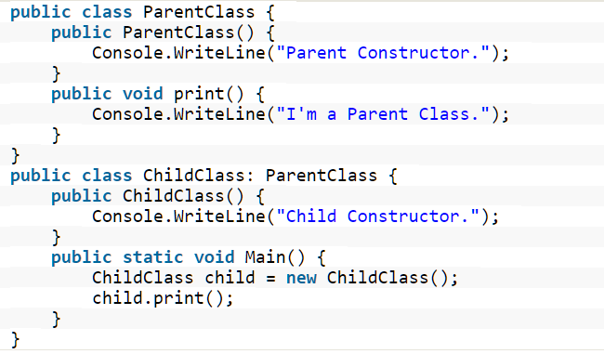
OOPS → Inheritance
When a class includes a property of another class it is known as inheritance.
Inheritance is a process of object reusability.

Slide 24
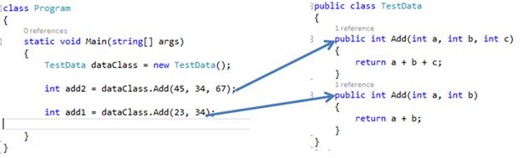
OOPS → Polymorphism
Polymorphism means one name, many forms.
One function behaves in different forms (overloading).

Slide 25
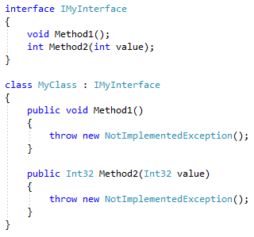
Interfaces

Slide 26
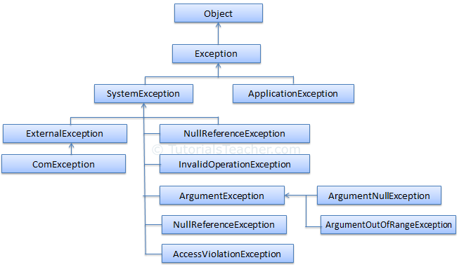
Exception handling

Slide 27
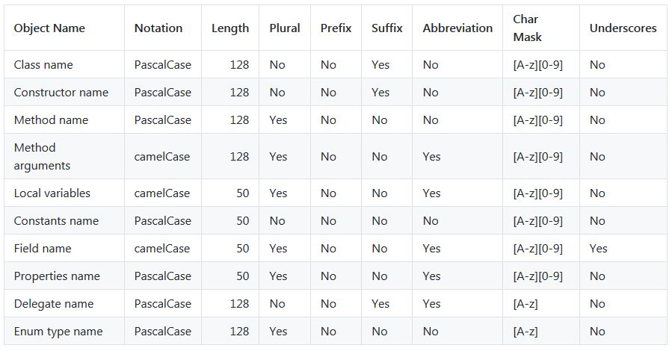
Comments & Naming Convention

Slide 28

!! Happy Coding !!

